Slide 1













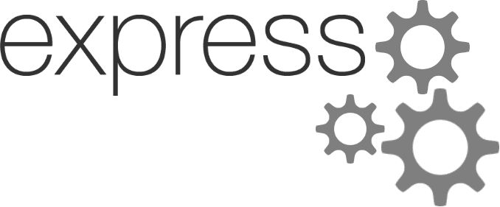


Slide 2

แหล่งอ้างอิง

Slide 3
Angular

Slide 4
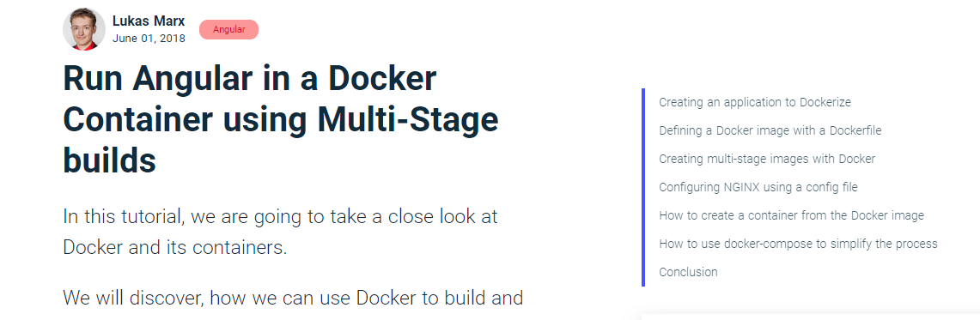
https://malcoded.com/posts/angular-docker/?fbclid=IwAR3BRsLK3Msxn6XuKo-hHWoTW-76mnnNuAdOuf0QpJ6siZKxKOgN9w0ifMQ

Slide 5
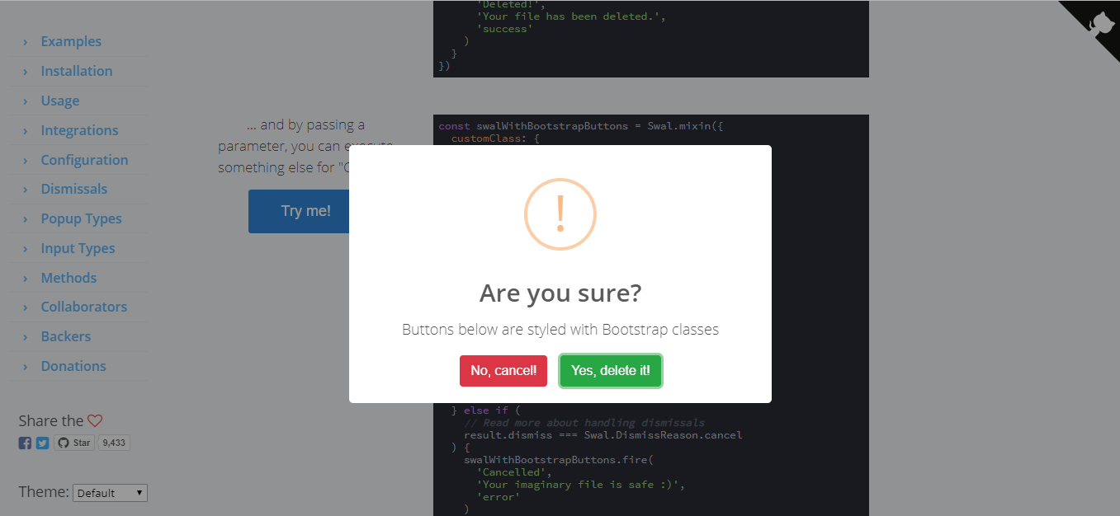
https://sweetalert2.github.io/

Slide 6
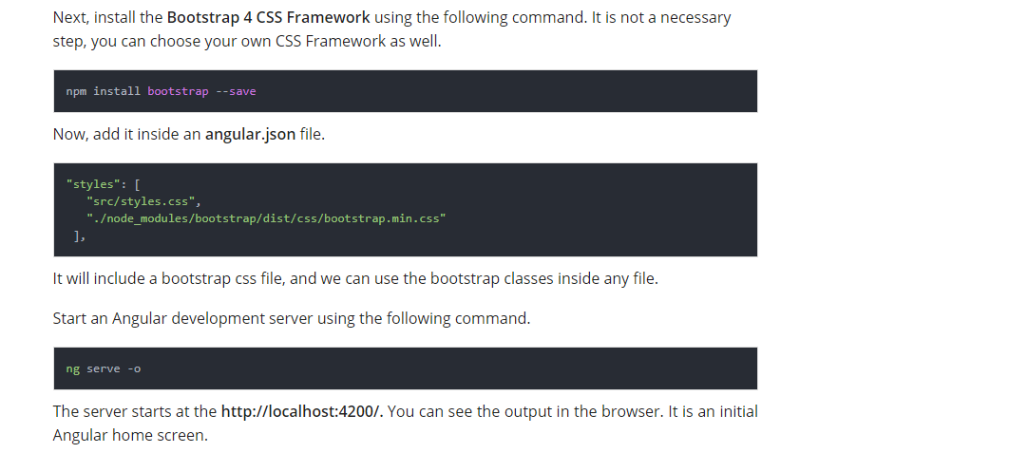
https://appdividend.com/2019/06/04/angular-8-tutorial-with-example-learn-angular-8-crud-from-scratch/

Slide 7

Node js

Slide 8
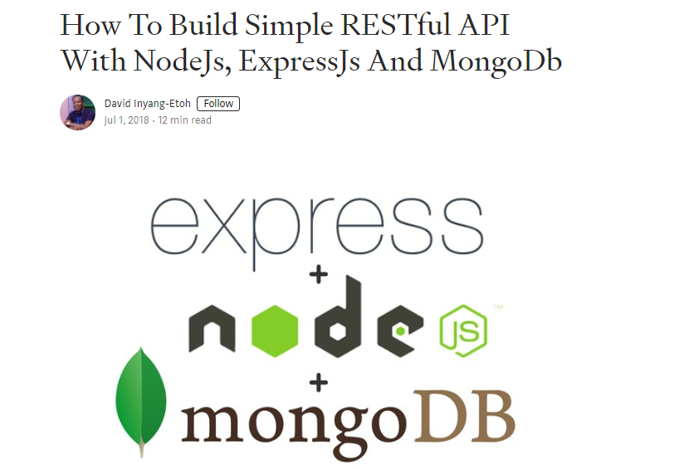
https://medium.com/@dinyangetoh/how-to-build-simple-restful-api-with-nodejs-expressjs-and-mongodb-99348012925d

Slide 9
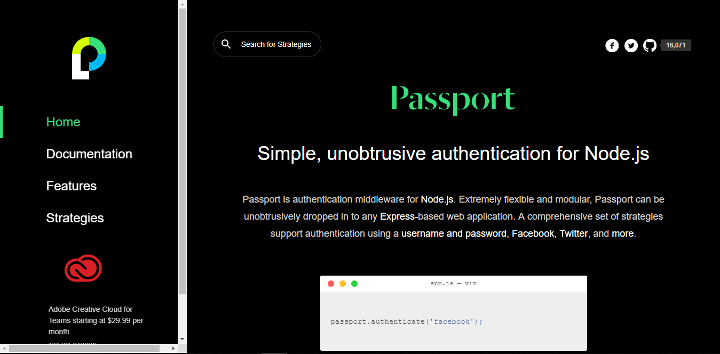
http://www.passportjs.org/

Slide 10
Docker

Slide 12
jest

Slide 13
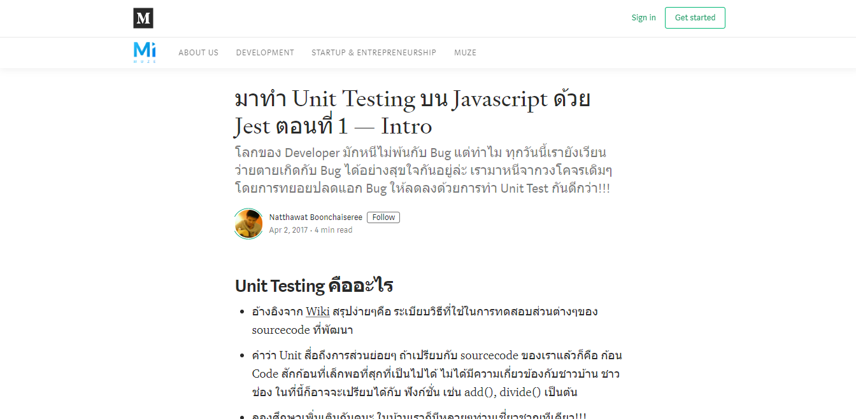
https://medium.com/muze-innovation/%E0%B8%A1%E0%B8%B2%E0%B8%97%E0%B8%B3-unit-testing-%E0%B8%9A%E0%B8%99-javascript-%E0%B8%94%E0%B9%89%E0%B8%A7%E0%B8%A2-jest-%E0%B8%95%E0%B8%AD%E0%B8%99%E0%B8%97%E0%B8%B5%E0%B9%88-1-7676dfb585b0

Slide 14
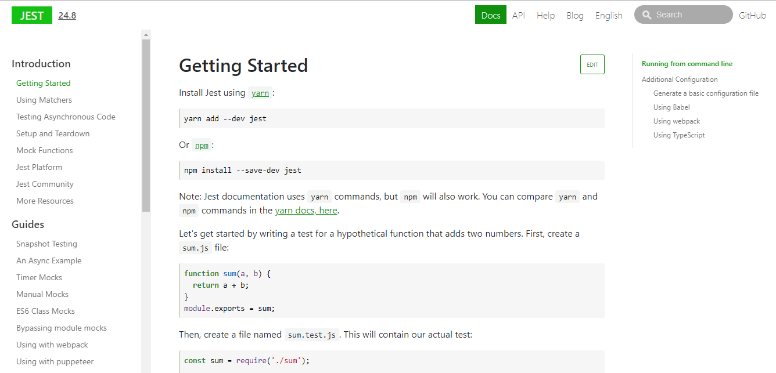
https://jestjs.io/docs/en/getting-started

Slide 17
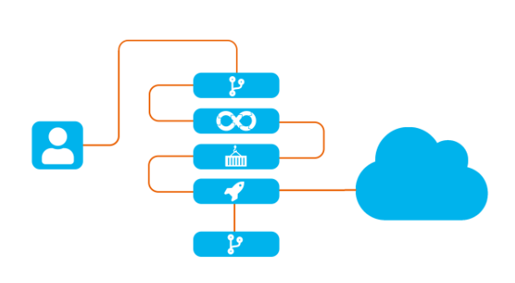


Slide 18
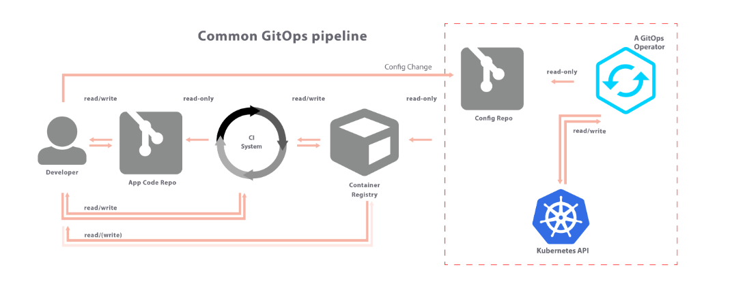
https://www.weave.works/blog/kubernetes-anti-patterns-let-s-do-gitops-not-ciops?fbclid=IwAR260VE5YEg7HKWBRVWDB56NTaBFyunnm1c9Hk4YQwXJOa9L_hUYyLQUj-Q

Slide 23


Slide 24
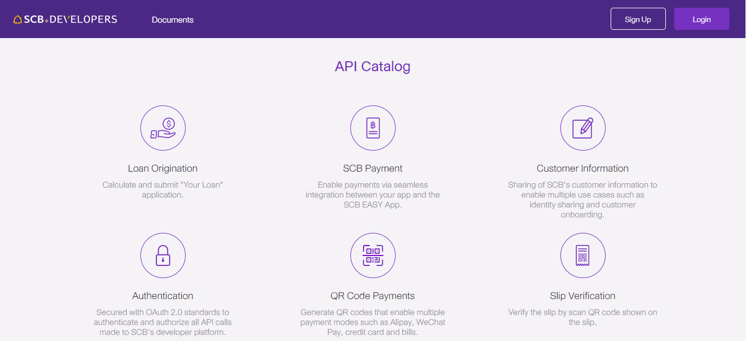
https://developer.scb/#/home

